Slide 1

Data Parallel Training in Pytorch
2230784 闫弘
2023.11.9

Slide 2
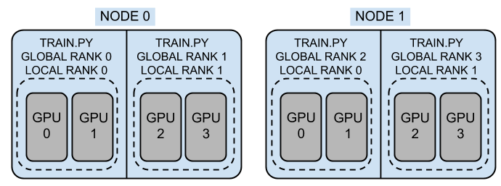
分布式训练中的基础概念
Node - A physical instance or a container; maps to the unit that the job manager works with.
RANK – (GLOBAL RANK)The rank of the worker within a worker group(process group).
WORLD_SIZE - The total number of workers in a worker group.
LOCAL_RANK - The rank of the worker within a local worker group.
LOCAL_WORLD_SIZE - The size of the local worker group.

Slide 3
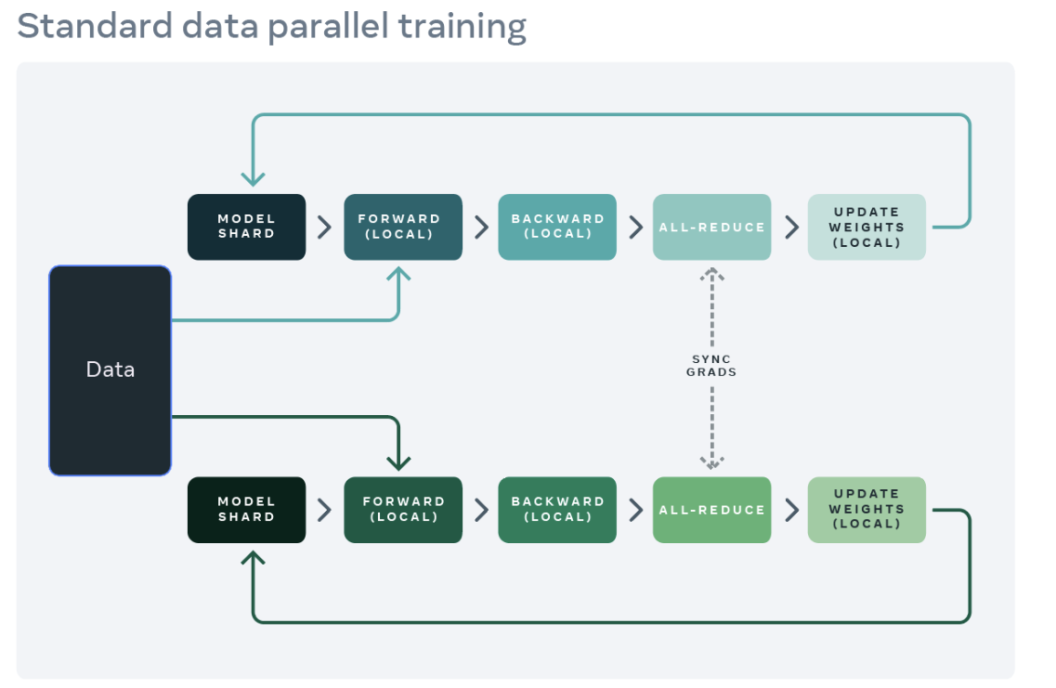
分布式训练=分布式通讯+进行模型训练

Slide 4
分布式训练
Q:如何在不同进程之间进行通讯？
用例：
最基础的方法（Point-to-Point）:send/receive
其他常用的方法（Collective Communication）：all-reduce, all-gather, reduce, broadcast, reduce-scatter
软硬件基础：
硬件基础：PCIe, NVLink, Nvswitch, InfiniBand Verbs or TCP/IP sockets（网络）
底层通讯库：Gloo,NCCL,MPI
PyTorch通讯的库：c10d （基于Gloo,NCCL,MPI完成不同进程间tensor的通讯）
PyTorch对c10d进一步封装：Distributed Data-Parallel Training (DDP) ,RPC-Based Distributed Training (RPC)
用户使用：
最终，只需要一行代码model=DDP(model:torch.nn.Module,device_id:int)
（Under the hood）在训练过程中，每一次计算得出gradients时都进行了all_reduce操作，确保：
1.更新时的gradients是所有进程计算出gradients的平均值
2.跟新时所有进程中的gradients都是同一个值

Slide 5
分布式训练
Q:如何在不同进程之间进行通讯？
用例：
最基础的方法（Point-to-Point）:send/receive
其他常用的方法（Collective Communication）：all-reduce, all-gather, reduce, broadcast, reduce-scatter
软硬件基础：
硬件基础：PCIe, NVLink, Nvswitch, InfiniBand Verbs or TCP/IP sockets（网络）
底层通讯库：Gloo,NCCL,MPI
PyTorch通讯的库：c10d （基于Gloo,NCCL,MPI完成不同进程间tensor的通讯）
PyTorch对c10d进一步封装：Distributed Data-Parallel Training (DDP) ,RPC-Based Distributed Training (RPC)
用户使用：
最终，只需要一行代码model=DDP(model:torch.nn.Module,device_id:int)
（Under the hood）在训练过程中，每一次计算得出gradients时都进行了all_reduce操作，确保：
1.更新时的gradients是所有进程计算出gradients的平均值
2.跟新时所有进程中的gradients都是同一个值

Slide 6
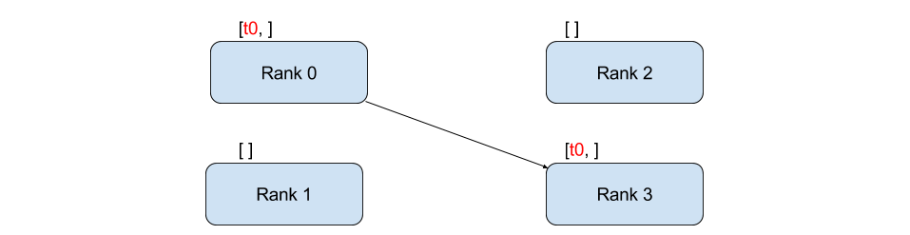
Point-to-Point
send/recv
"""Blocking point-to-point communication."""
def run(rank, size):
tensor = torch.zeros(1)
if rank == 0:
tensor += 1
# Send the tensor to process 1
dist.send(tensor=tensor, dst=1)
else:
# Receive tensor from process 0
dist.recv(tensor=tensor, src=0)
print('Rank ', rank, ' has data ', tensor[0])
https://pytorch.org/tutorials/intermediate/dist_tuto.html#

Slide 7
Point-to-Point
isend/irecv
"""Non-blocking point-to-point communication."""
def run(rank, size):
tensor = torch.zeros(1)
req = None
if rank == 0:
tensor += 1
# Send the tensor to process 1
req = dist.isend(tensor=tensor, dst=1)
print('Rank 0 started sending')
else:
# Receive tensor from process 0
req = dist.irecv(tensor=tensor, src=0)
print('Rank 1 started receiving')
req.wait()
print('Rank ', rank, ' has data ', tensor[0])
https://pytorch.org/tutorials/intermediate/dist_tuto.html#

Slide 8
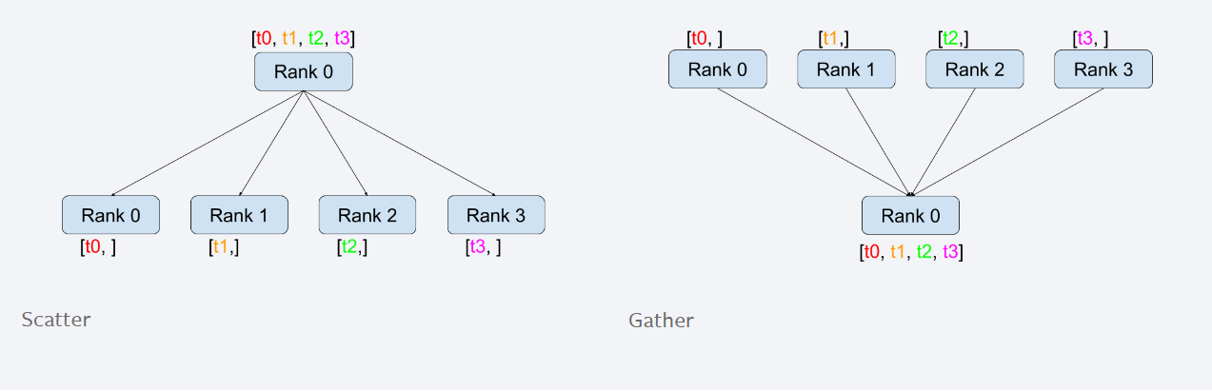
Collective Communication
https://pytorch.org/tutorials/intermediate/dist_tuto.html#

Slide 9
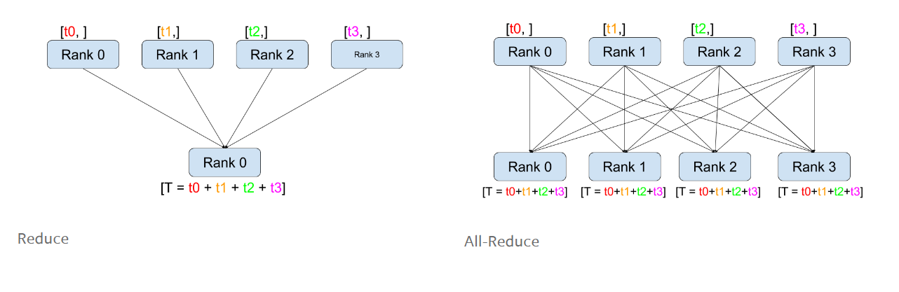
Collective Communication
https://pytorch.org/tutorials/intermediate/dist_tuto.html#

Slide 10
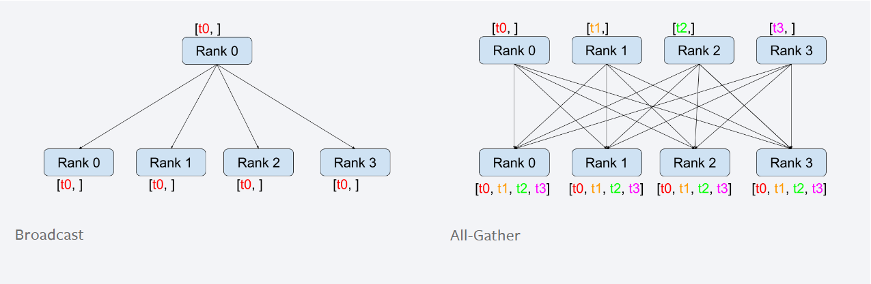
Collective Communication
https://pytorch.org/tutorials/intermediate/dist_tuto.html#

Slide 11
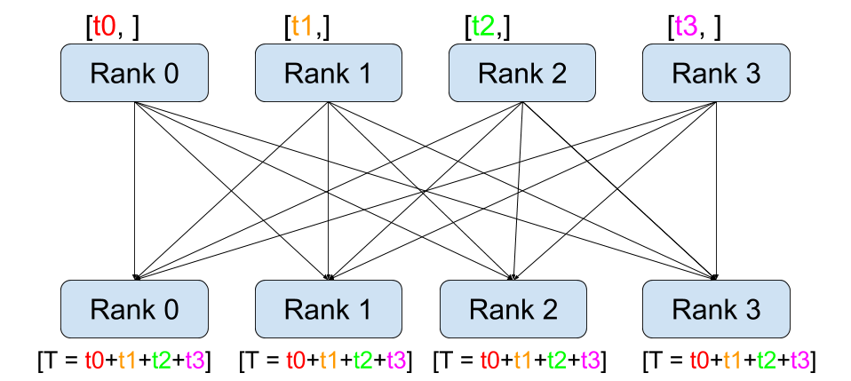
Collective Communication
""" All-Reduce example."""
def run(rank, size):
""" Simple collective communication. """
group = dist.new_group([0, 1])
tensor = torch.ones(1)
dist.all_reduce(tensor, op=dist.ReduceOp.SUM, group=group)
print('Rank ', rank, ' has data ', tensor[0])
https://pytorch.org/tutorials/intermediate/dist_tuto.html#

Slide 12
分布式训练
Q:如何在不同进程之间进行通讯？
用例：
最基础的方法（Point-to-Point）:send/receive
其他常用的方法（Collective Communication）：all-reduce, all-gather, reduce, broadcast, reduce-scatter
软硬件基础：
硬件基础：PCIe, NVLink, Nvswitch, InfiniBand Verbs or TCP/IP sockets（网络）
底层通讯库：Gloo,NCCL,MPI
PyTorch通讯的库：c10d （基于Gloo,NCCL,MPI完成不同进程间tensor的通讯）
PyTorch对c10d进一步封装：Distributed Data-Parallel Training (DDP) ,RPC-Based Distributed Training (RPC)
用户使用：
最终，只需要一行代码model=DDP(model:torch.nn.Module,device_id:int)
（Under the hood）在训练过程中，每一次计算得出gradients时都进行了all_reduce操作，确保：
1.更新时的gradients是所有进程计算出gradients的平均值
2.跟新时所有进程中的gradients都是同一个值

Slide 13
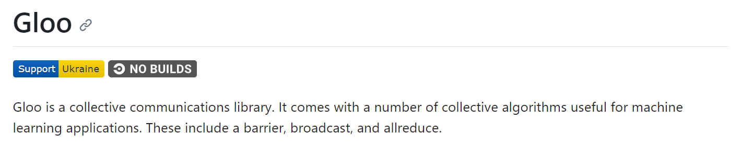
Gloo
https://github.com/facebookincubator/gloo

Slide 14
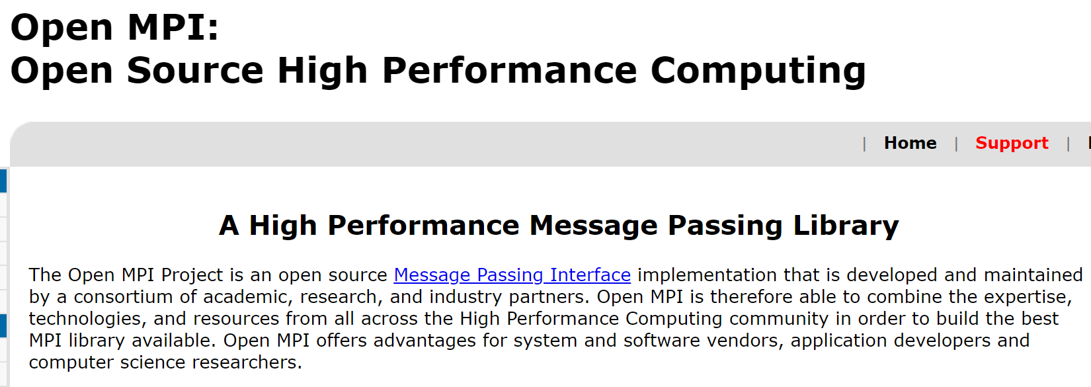
MPI
https://www.open-mpi.org/

Slide 15
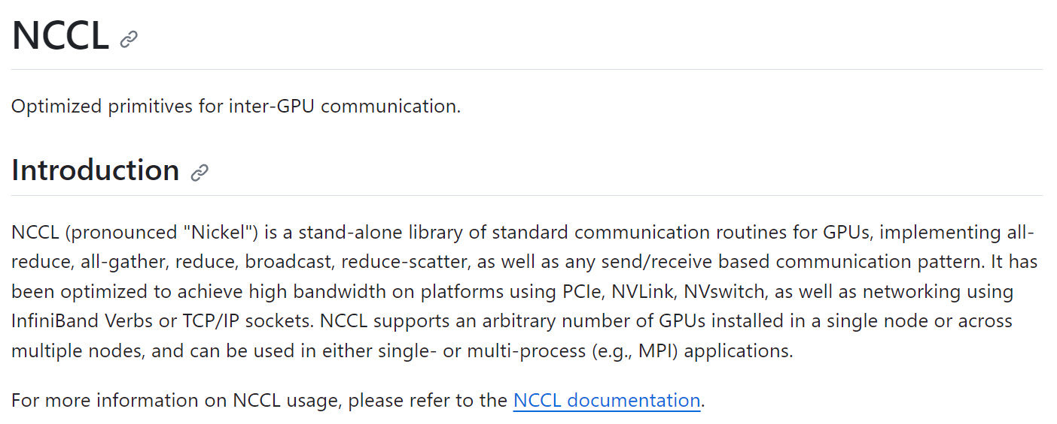
NCCL
https://github.com/NVIDIA/nccl

Slide 16
不同后端对通讯方式的支持
Backend | gloo |  | mpi |  | nccl
Device | CPU | GPU | CPU | GPU | CPU | GPU
send | ✓ | ✘ | ✓ | ? | ✘ | ✓
recv | ✓ | ✘ | ✓ | ? | ✘ | ✓
broadcast | ✓ | ✓ | ✓ | ? | ✘ | ✓
all_reduce | ✓ | ✓ | ✓ | ? | ✘ | ✓
reduce | ✓ | ✘ | ✓ | ? | ✘ | ✓
all_gather | ✓ | ✘ | ✓ | ? | ✘ | ✓
gather | ✓ | ✘ | ✓ | ? | ✘ | ✓
scatter | ✓ | ✘ | ✓ | ? | ✘ | ✓
reduce_scatter | ✘ | ✘ | ✘ | ✘ | ✘ | ✓
all_to_all | ✘ | ✘ | ✓ | ? | ✘ | ✓
barrier | ✓ | ✘ | ✓ | ? | ✘ | ✓
https://pytorch.org/docs/stable/distributed.html#
Notes:
简单地来说，gloo对CPU支持比较好，也支持GPU的集体通讯
MPI用于高性能计算 NCCL对GPU支持最好，也效果最好

Slide 17
Pytorch 进程初始化方式
其实也就是进程是如何建立连接，有3种方法：TCP initialization, Shared file-system initialization, Environment variable initialization
# Use address of one of the machines
dist.init_process_group(backend, init_method='tcp://10.1.1.20:23456',
rank=args.rank, world_size=4)
# rank should always be specified
dist.init_process_group(backend, init_method='file:///mnt/nfs/sharedfile',
world_size=4, rank=args.rank)
MASTER_PORT - required; has to be a free port on machine with rank 0
MASTER_ADDR - required (except for rank 0); address of rank 0 node
WORLD_SIZE - required; can be set either here, or in a call to init function
RANK - required; can be set either here, or in a call to init function
https://pytorch.org/docs/stable/distributed.html#tcp-initialization

Slide 18
Pytorch 创建进程组方法
其实也就是如何创建多进程，有两种方法：Launch utility, Spawn utility
Launch utility就是用torch.distributed中提供的launch.py工具文件，采用如下格式产生多进程：
python -m torch.distributed.launch --nproc-per-node=NUM_GPUS_YOU_HAVE
--nnodes=2 --node-rank=0 --master-addr="192.168.1.1"
--master-port=1234 YOUR_TRAINING_SCRIPT.py
Spawn utility则是用torch.multiprocessing的spawn方法，这样也可以产生多进程，但似乎无法直接做到多结点（也就是跨机器）运行
https://github.com/pytorch/examples/blob/main/distributed/ddp/README.md
https://pytorch.org/docs/stable/distributed.html#launch-utility

Slide 19
分布式训练
Q:如何在不同进程之间进行通讯？
用例：
最基础的方法（Point-to-Point）:send/receive
其他常用的方法（Collective Communication）：all-reduce, all-gather, reduce, broadcast, reduce-scatter
软硬件基础：
硬件基础：PCIe, NVLink, Nvswitch, InfiniBand Verbs or TCP/IP sockets（网络）
底层通讯库：Gloo,NCCL,MPI
PyTorch通讯的库：c10d （基于Gloo,NCCL,MPI完成不同进程间tensor的通讯）
PyTorch对c10d进一步封装：Distributed Data-Parallel Training (DDP) ,RPC-Based Distributed Training (RPC)
用户使用：
最终，只需要一行代码model=DDP(model:torch.nn.Module,device_id:int)
（Under the hood）在训练过程中，每一次计算得出gradients时都进行了all_reduce操作，确保：
1.更新时的gradients是所有进程计算出gradients的平均值
2.跟新时所有进程中的gradients都是同一个值

Slide 20
使用自己模型的一些注意事项
主要有两点需要注意的：
模型装载
model=DDP(model, device_id=local_rank)
数据装载
Train_data=DataLoader(dataset,batch_size=batch_size,pin_memory=True,shuffle=False,sampler=DistributedSampler(dataset))
具体也可以手动分配训练数据：https://pytorch.org/tutorials/intermediate/dist_tuto.html#distributed-training

Slide 21
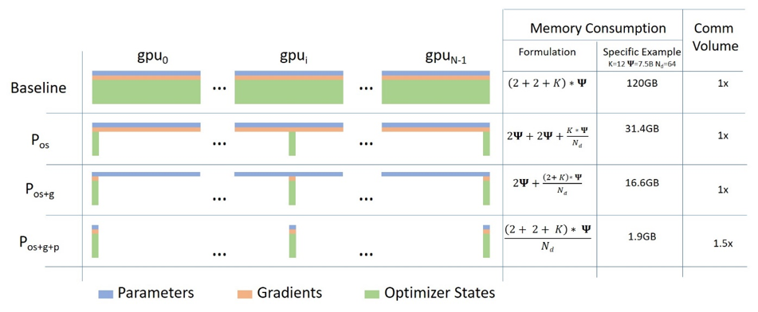
训练更大参数的模型的方法 ZeRO
到目前为止，分布式训练仍然在每一个设备(GPU）上都有一份模型参数、优化器参数以及gradients的备份，这种重复会极大地浪费显卡的内存，于是微软deepspeed就提出了ZeRo的优化方法，先后分别有ZeRO-1，ZeRO-2和ZeRO-3 3种：
Rajbhandari, Samyam, et al. "Zero: Memory optimizations toward training trillion parameter models." SC20: International Conference for High Performance Computing, Networking, Storage and Analysis. IEEE, 2020.

Slide 22
Pytorch ZeRO-1
ZeRO-1是针对optimizer的state进行优化的，pytorch中只需要将optimizer修改成对应的ZeroRedundancyOptimizer即可
from torch.distributed.optim import ZeroRedundancyOptimizer
if use_zero:
optimizer = ZeroRedundancyOptimizer(
ddp_model.parameters(),
optimizer_class=torch.optim.Adam,
lr=0.01
)
else:
optimizer = torch.optim.Adam(ddp_model.parameters(), lr=0.01)
https://pytorch.org/tutorials/recipes/zero_redundancy_optimizer.html

Slide 23
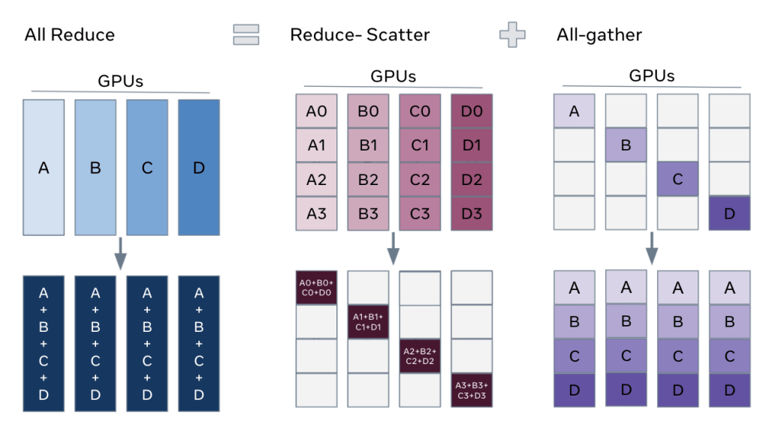
Pytorch FSDP (ZeRO-3)
ZeRO-3对模型参数，优化器参数和gradients都进行了优化，在pytorch中对应的方法叫 FULLY SHARDED DATA PARALLEL(FSDP)
它的工作原理是基于如下一个事实：
https://pytorch.org/tutorials/intermediate/FSDP_tutorial.html
https://engineering.fb.com/2021/07/15/open-source/fsdp/

Slide 24
Pytorch FSDP (ZeRO-3)
https://engineering.fb.com/2021/07/15/open-source/fsdp/

Slide 25
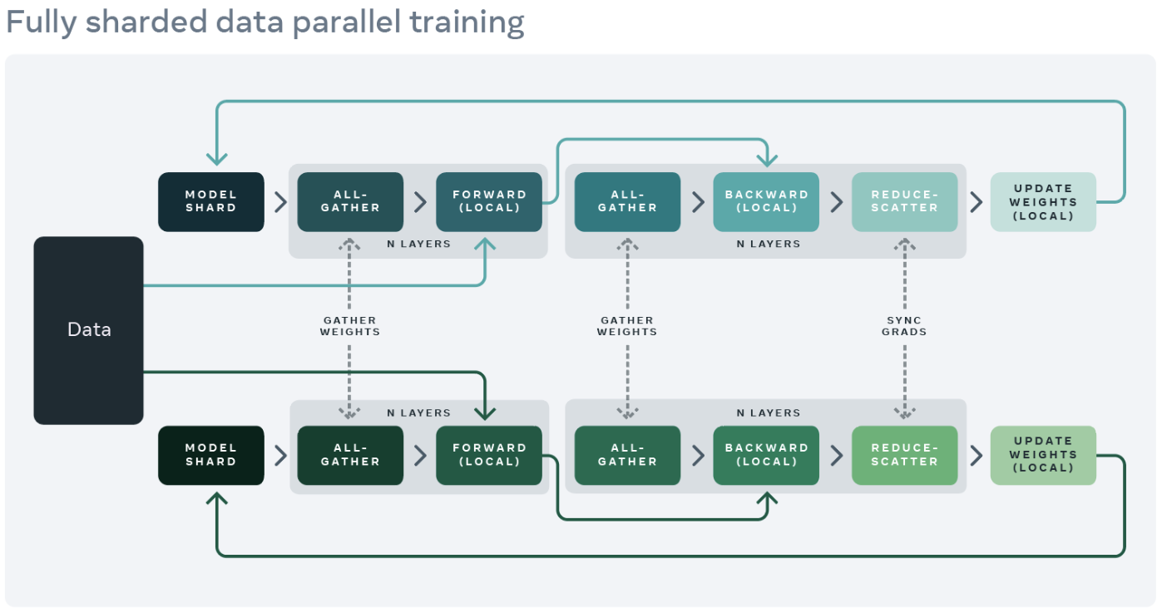
Pytorch FSDP (ZeRO-3)
https://engineering.fb.com/2021/07/15/open-source/fsdp/

Slide 26
DeepSpeed
DeepSpeed model training is accomplished using the DeepSpeed engine. The engine can wrap any arbitrary model of type torch.nn.module and has a minimal set of APIs for training and checkpointing the model.
model_engine, optimizer, _, _ = deepspeed.initialize(args=cmd_args,
model=model,
model_parameters=params)
DeepSpeed can construct and manage the training optimizer, data loader, and the learning rate scheduler based on the parameters passed to deepspeed.initialize and the DeepSpeed configuration file
https://www.deepspeed.ai/getting-started/

Slide 27
DeepSpeed
完成初始化后训练只需要简单的三行代码：
for step, batch in enumerate(data_loader):
loss = model_engine(batch)
model_engine.backward(loss)
model_engine.step()
还内置了许多功能：梯度平均化（分布式训练）、损失精度缩放（混合精度训练）、学习率动态调整（训练过程）。当然，还可以增加ZeRO功能以及MoE功能，能更好地优化训练过程、训练更大的模型。
评价：是对Pytorch DDP的进一步封装改进，使其更加专注于模型的训练，而且也确实便捷好用。
https://www.deepspeed.ai/getting-started/

Slide 28
请老师同学批评指正
2230784 闫弘

